Slide 1





Coffee and Coding
An Intro to R in NISRA
Trusted statistics and research for a better society

Slide 2

Why R?
R is 100% free and as a result, has a huge support community
Flexible and extensible – thousands of user created packages via CRAN/Github
Paid for software, SPSS, SAS generally declining
NISRA direction is to use R as a default enabling simpler cross working between teams and departments
R is incredibly versatile in what you can do - everything from calculating simple summary statistics, to performing complex simulations to creating plots
Using RStudio, a program to help you write R code, You can easily and seamlessly combine R code, analyses, plots, and written text into elegant digital documents all in one place using Rmarkdown or Quarto
Analyses conducted in R are transparent, easily shareable, and reproducible, especially when paired with git

Slide 3
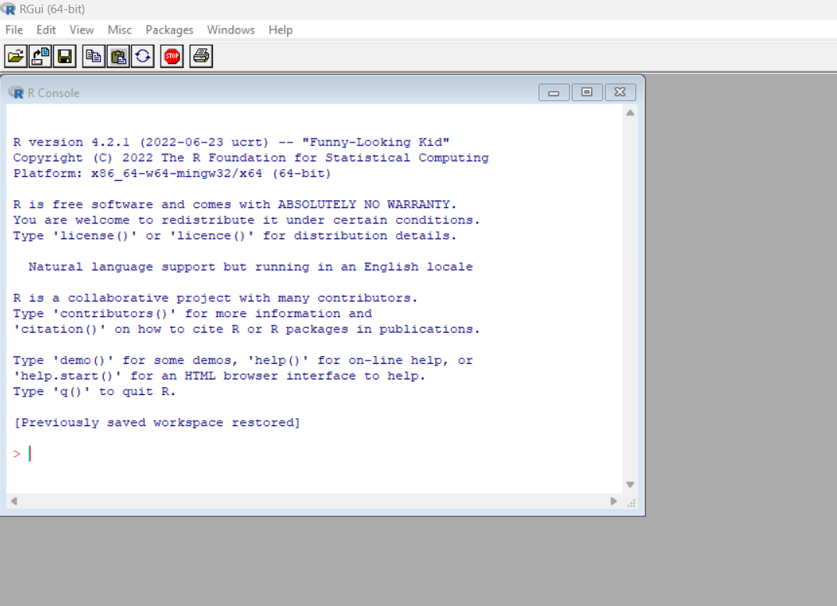
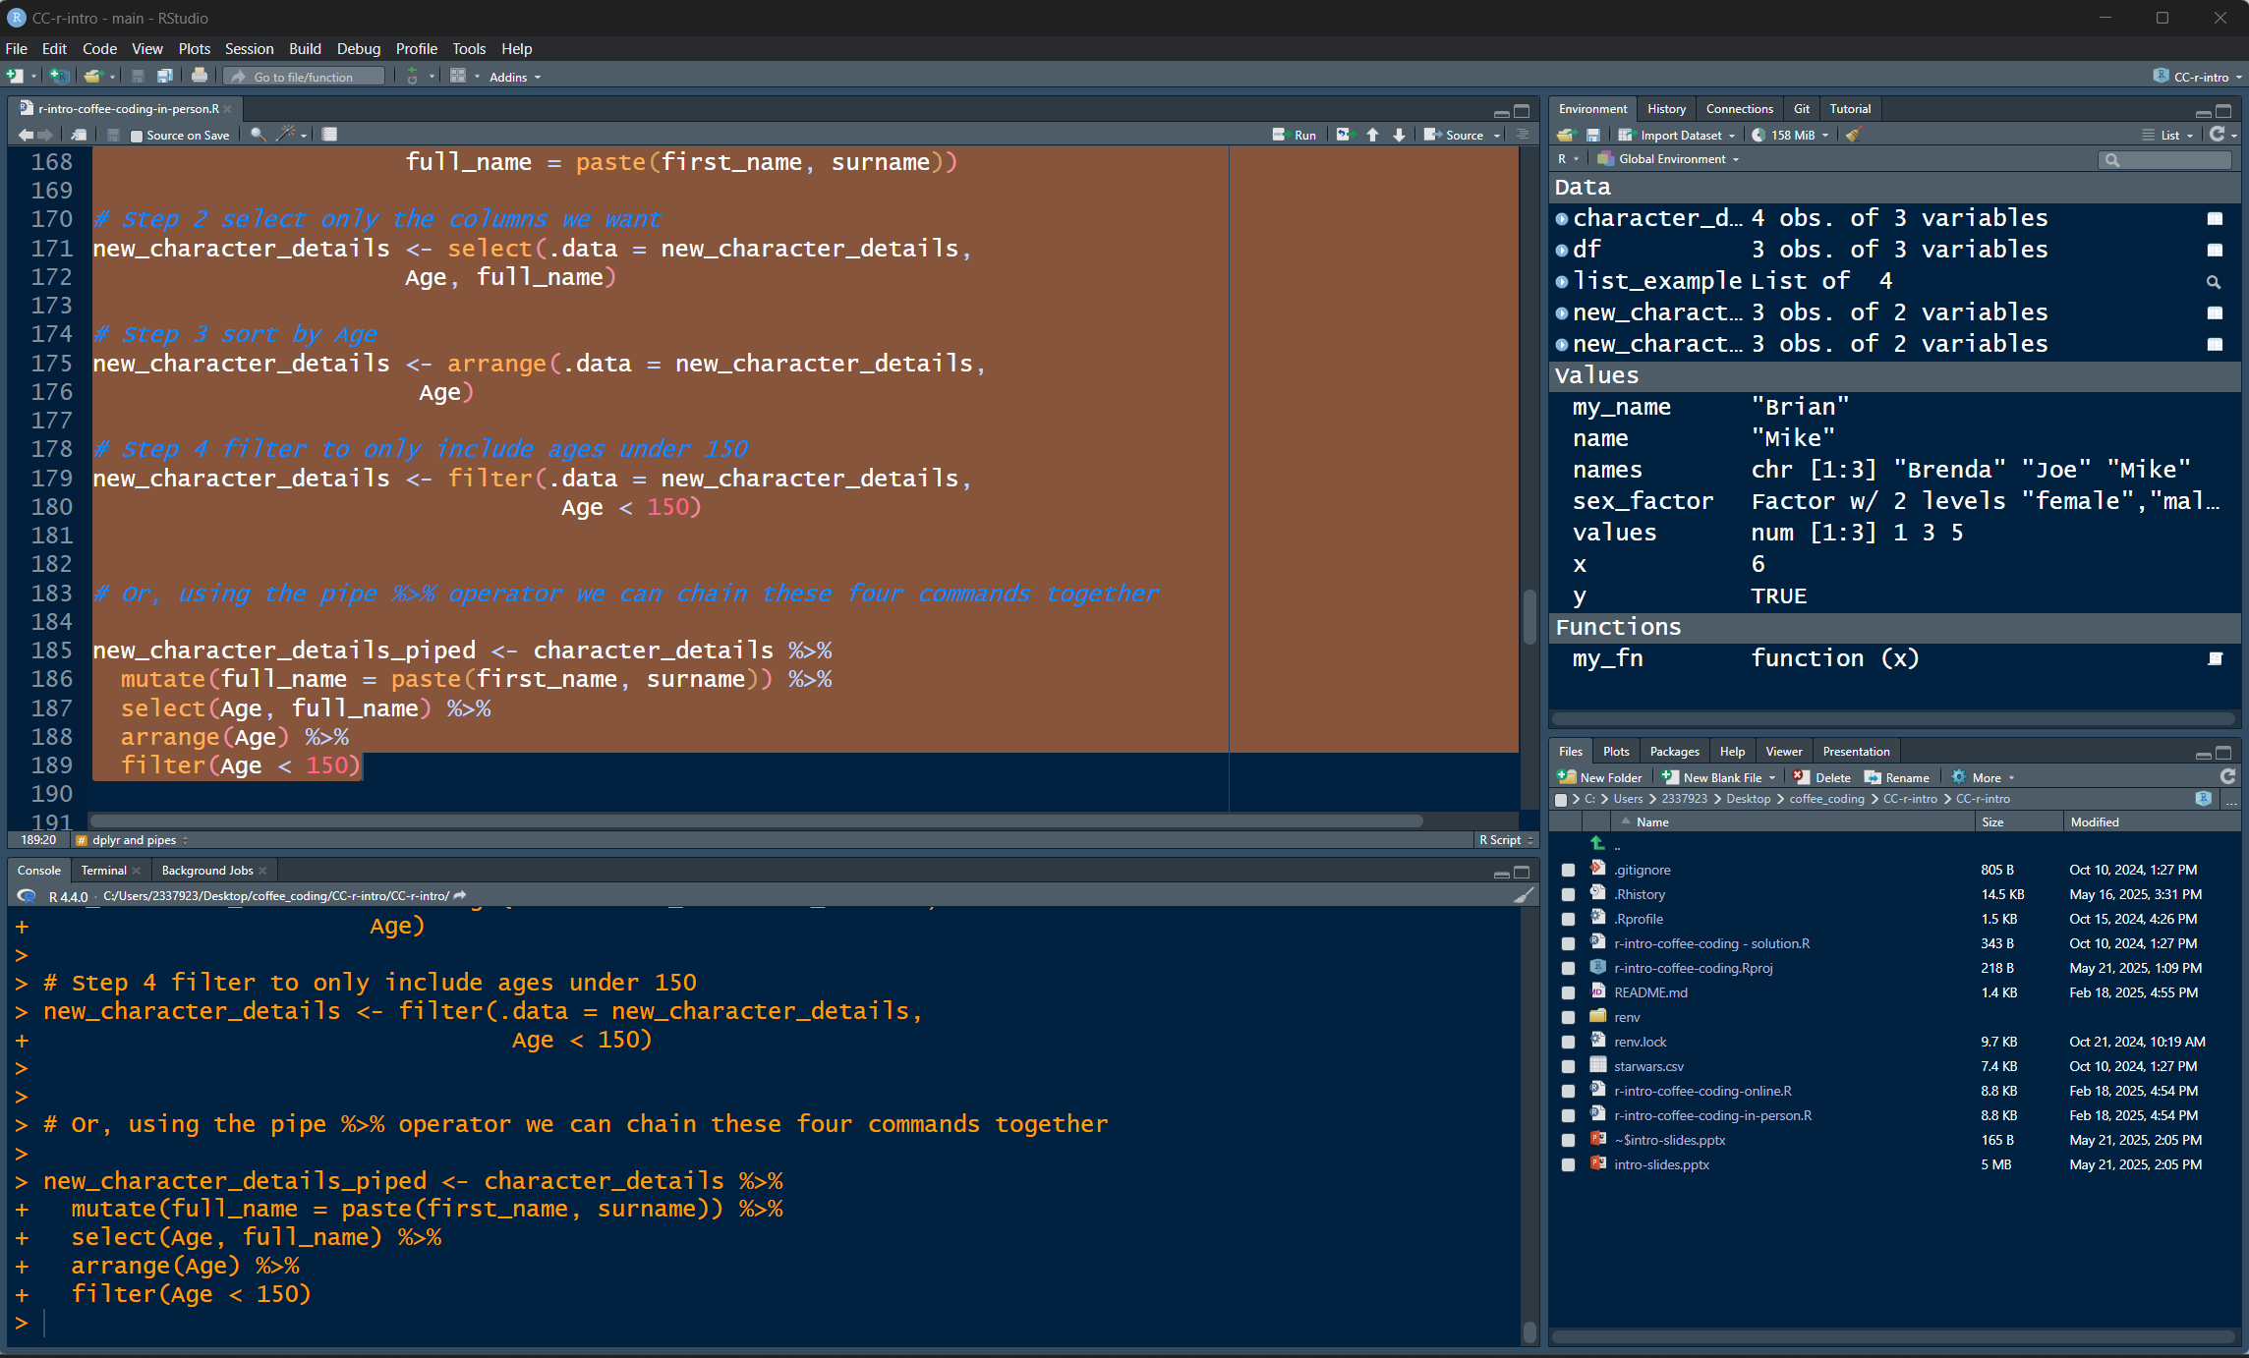
R vs R Studio
R is a software with different versions available e.g. v4.2.1, v4.4.0
Rstudio is a development environment (IDE) that is made for R
RGui (Standard R)
RStudio

Slide 4
Future Developments
Resources on TM-DOF-NISRATEAM Staff Training Page – Links to Online Training tab
Development of Tidyverse understanding
majority of data work in NISRA can be done with these tools
Use of Rmarkdown/Quarto to create HTML outputs
Tech Lab RAP Skeleton
Tech Lab RAP Skeleton Lite
Coffee and Coding sessions on Intro to RMarkdown in NISRA, RAP Skeleton and RAP Skeleton Lite
Git and Github for code versioning – coffee and coding planned for July 2025
R forum – contact BSDB (Kim Jordan or Laura McIlwee

